Slide 1

ADVANCED FILTRATION CONCEPTS
Filter service you can scan.
A ten-minute look at AFC Field and the AFC Hospital Portal.
AFC Field · technicians record the work
AFC Hospital Portal · the hospital sees status, not the shop
323.832.8316
Notes:
Open on this slide. One sentence: AFC services hospital air handlers, and these two apps are how the work gets recorded and how the hospital sees it. Then: Field is for our techs. Portal is read-only for the hospital.

Slide 2
Why this exists
2 / 10
On the unit
What filters are in it, how many, what size, and when they are due.
In the field
A tech should scan a sticker, do the changeout, and leave a record — even if the phone had to close.
In the office
A director should see on-schedule / due / overdue for their hospital, without calling AFC for a spreadsheet.
Advanced Filtration Concepts · 323.832.8316 · Confidential — for AFC presentations
Notes:
The pain is split three ways: the sticker on the unit, the tech in the penthouse, and facilities in the office. Paper books and 'ask the last guy' do not scale. This system is the same survey for all three.

Slide 3
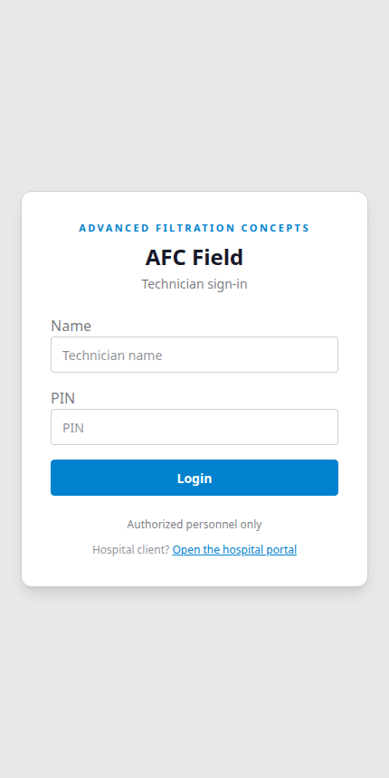
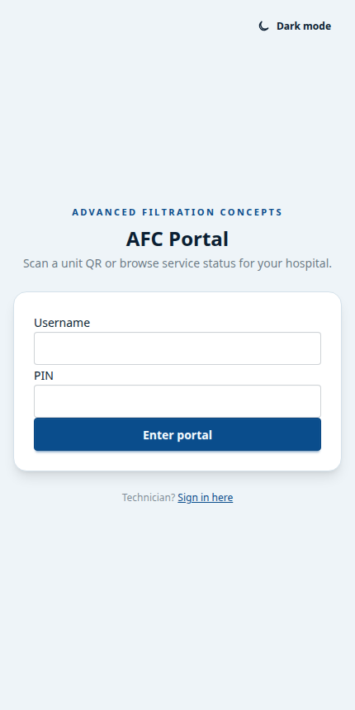
Two apps. One survey.
3 / 10
AFC Field
For AFC technicians
AFC Portal
For the hospital
Scan · complete jobs · offline hospital download
Read-only status · same QR sticker · no prices
Advanced Filtration Concepts · 323.832.8316 · Confidential — for AFC presentations
Notes:
Same login idea (name/username + PIN), different product. Hospital logins cannot open Field tools. Field tokens cannot open portal APIs. One sticker on the AHU: techs get the job, hospital logins get status.

Slide 4
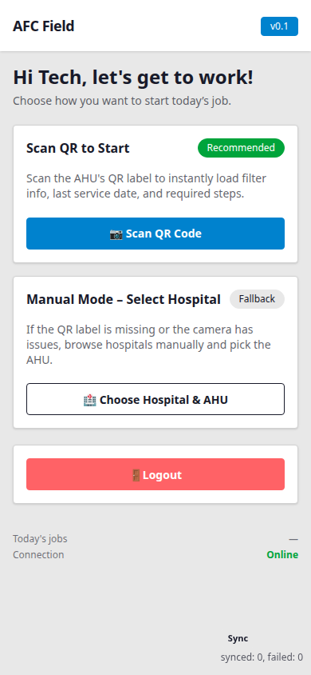
AFC Field — the tech’s day
4 / 10
Scan first. Manual is the fallback.
▸ Scan the AHU sticker → filters, last service, next due.
▸ Complete the changeout on the phone. Queue it if the roof has no signal.
▸ Download a hospital before you go. Jobs sync when you are back online.
▸ Close the app and come back — you stay signed in while the session is valid.
Advanced Filtration Concepts · 323.832.8316 · Confidential — for AFC presentations
Notes:
Walk the flow: open AFC Field, scan, do the job. Offline: download the hospital from the list, then you can still work. Reopen: they used to hit login every time because the PWA started on the PIN screen; that now resumes Home if the token is still good. Tokens still expire at 12 hours.

Slide 5
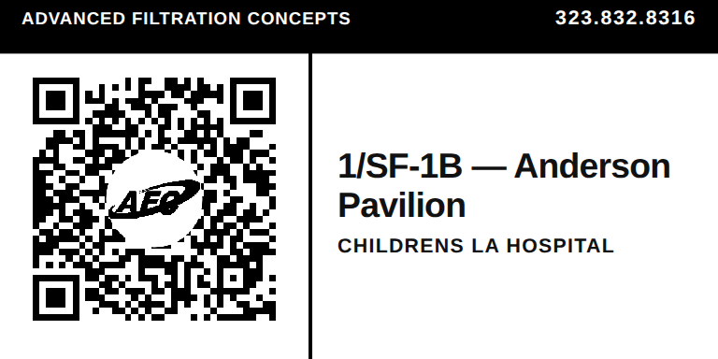
Every unit gets a 4×2 sticker
5 / 10
Headline is the AHU and the building. Hospital name sits under it. AFC mark is in the QR. Same label for our techs and for hospital staff.
Advanced Filtration Concepts · 323.832.8316 · Confidential — for AFC presentations
Notes:
Hold up a real label if you have one. Point out: AHU — building is what you read from ten feet away. Hospital name is confirmation. QR is the database row, not a PDF. Scan as a logged-in tech → FilterInfo. Scan as a hospital login → portal unit page. Scan logged out → sign-in, then the unit.

Slide 6
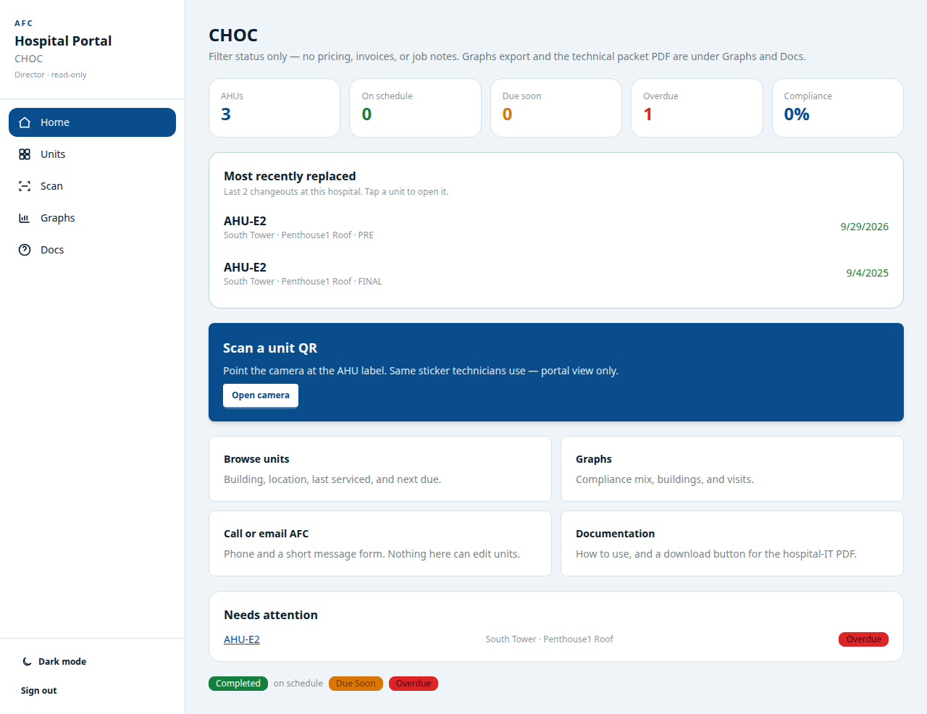
AFC Portal — the hospital’s view
6 / 10
Advanced Filtration Concepts · 323.832.8316 · Confidential — for AFC presentations
Notes:
This is director home. Counts: AHUs, on schedule, due soon, overdue, compliance. Most recently replaced is the last changeouts at this hospital. Scan uses the same sticker. Browse units by building. Graphs and Docs are director-only. Nothing on this screen is a price.

Slide 7
Who sees what
7 / 10
AFC technician
Hospital director
Hospital technician
▸ Scan and complete jobs
▸ Part numbers and quantities
▸ Offline hospital download
▸ Admin tools if they are an admin
▸ Home dashboard
▸ All units + scan
▸ Graphs and PDF export
▸ IT packet + contact AFC
▸ Units and scan only
▸ Read-only skip comments
▸ How-to guide
▸ No graphs, no packet, no contact
Advanced Filtration Concepts · 323.832.8316 · Confidential — for AFC presentations
Notes:
Stress server-side roles. Editing the browser cannot promote a floor tech to director. Hospital-tech has a shorter nav on purpose — Units, Scan, Guide. Directors get Graphs and Docs. AFC techs are a different login entirely.

Slide 8
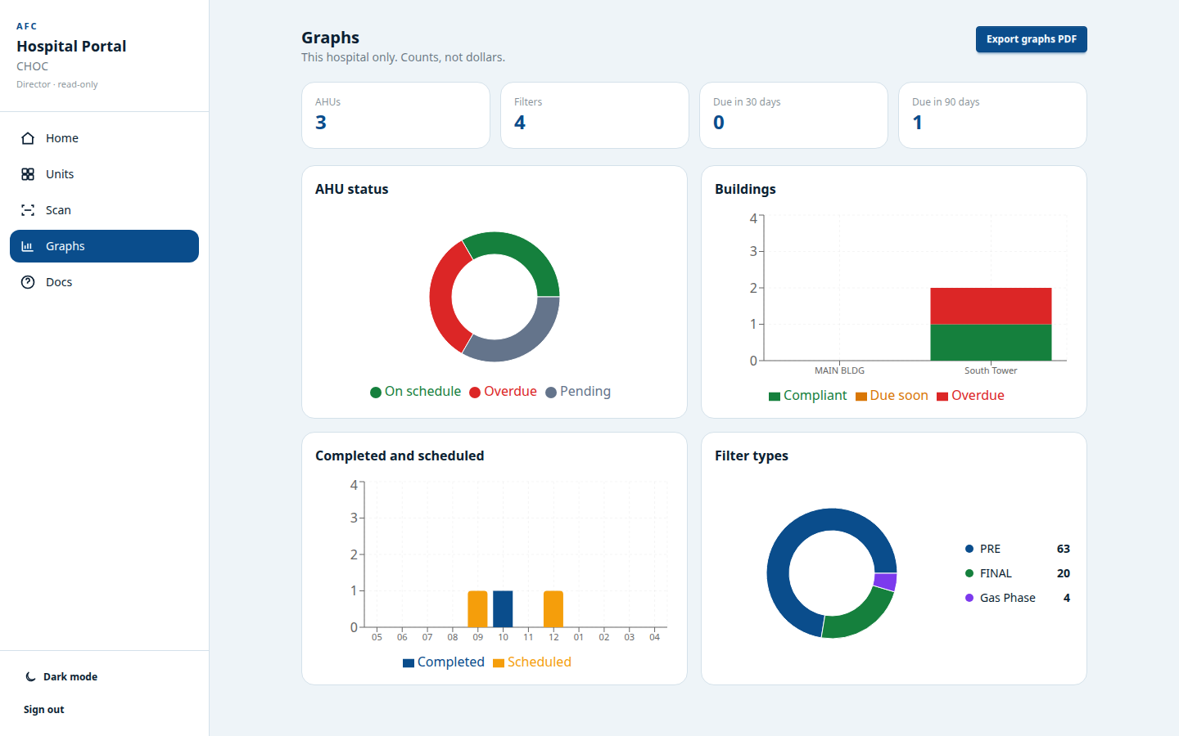
Directors get graphs. Counts, not dollars.
8 / 10
Advanced Filtration Concepts · 323.832.8316 · Confidential — for AFC presentations
Notes:
Four tiles: AHU status donut, buildings stacked by compliant / due / overdue, completed vs scheduled services, filter-type quantities. Export graphs PDF for a meeting. This hospital only. Not a Joint Commission record — say that out loud if IS or Quality is in the room.

Slide 9
What the hospital never sees
9 / 10
Prices, invoices, POs
The portal is status, not a catalog.
Catalog part numbers on unit pages
Directors may see type quantities on graphs. Stickers and unit pages do not show PNs.
GPS, AFC tech names, job notes
Internal to Field. Hospital sees skip comments only, read-only.
Other hospitals
Every query is locked to the login’s hospital. There is no picker.
Writes
No edit, no delete, no import. Scan is view. Contact is a message to AFC.
PHI
AHU names and filter PM dates. Not patients. Not an EHR. IT packet is in Docs.
Advanced Filtration Concepts · 323.832.8316 · Confidential — for AFC presentations
Notes:
This is the slide for hospital IT and for AFC sales. Read-only, hospital-scoped, no PHI. Username + PIN, 12-hour session. Technical packet PDF is what IS usually files. Phone 323.832.8316 if they want the packet walked.

Slide 10
Scan the unit. Do the job. See the status.
AFC Field — our technicians
AFC Portal — the hospital, read-only
Same sticker. Same survey. Different doors.
Questions? 323.832.8316
Notes:
Stop talking. Offer a live scan on a phone if you have a sticker in the room. If they ask for IT detail, go to Docs → Download PDF. If they ask about SSO/MFA, be honest: not offered yet; call it a known gap from the packet.

